Slide 1
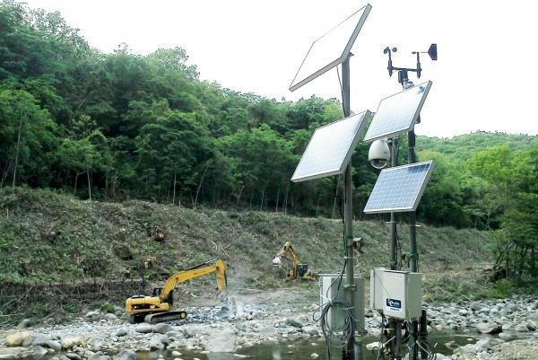
FLOOD MONITORING AND EARLY WARNING SYSTEM (I O T)
NAME: SWARNA N
NM: au721221106110
EMAIL: nagarajnagan1968@gmail.com
PHASE: 3

Slide 2
TABLE OF CONTENTS
Introduction ........................................... 3
Development Part 1 ................................ 4
Program Script.........................................5
Conclusion………………………………6

Slide 3
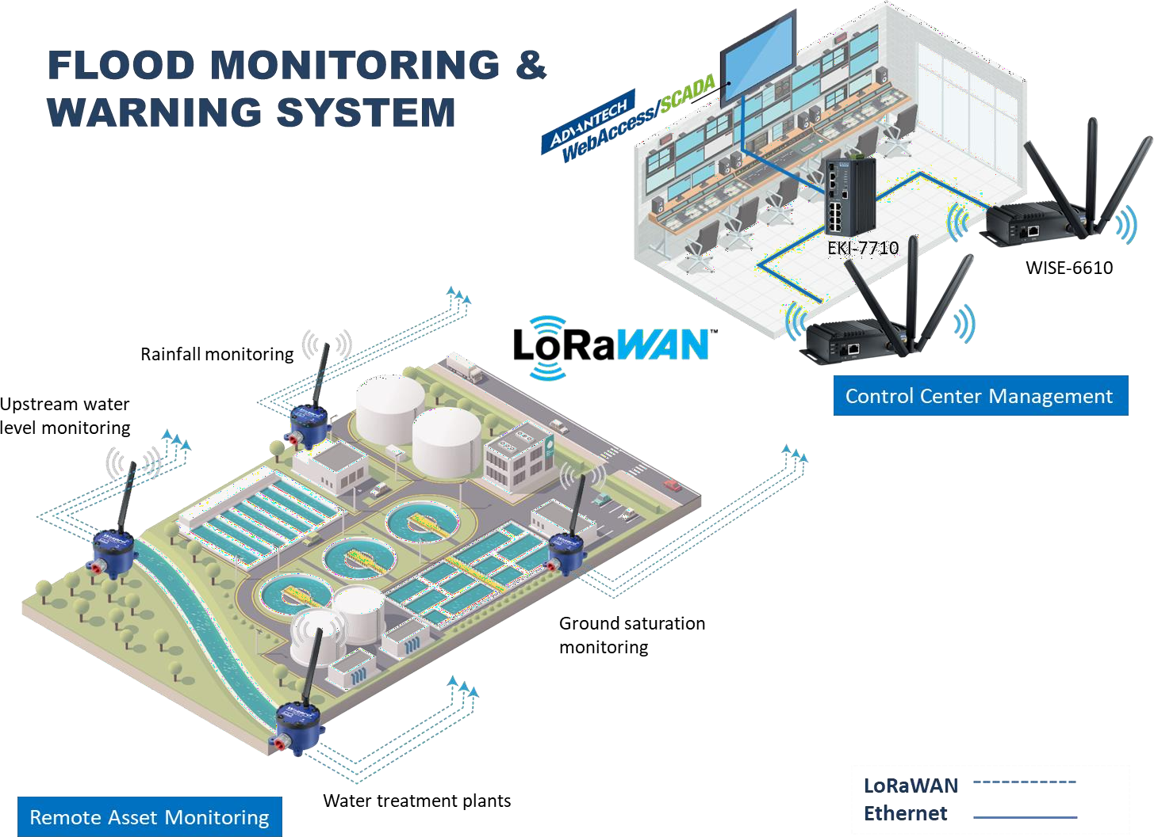
INTRODUCTION:
Flood monitoring and early warning systems in the context of the Internet of Things (IOT) represent a transformative approach
to mitigating the devastating impact of floods. These systems harness the capabilities of interconnected devices and sensors to
provide real-time data, predictive insights, and timely alerts in flood-prone regions.
By combining the power of IOT technology with advanced data analytics, these systems enable us to monitor weather
conditions, water levels, and environmental parameters, thus identifying potential flood risks.

Slide 4
DEVELOPMENT PART 1
Hardware and Components:
GSM module (SIM 8001):
The SIM8001 is a GSM (Global System for Mobile Communications) module used for
wireless communication over cellular networks. It supports 2G (GSM/GPRS) networks and provides
features like data transmission, SMS messaging, voice calls, and AT command control.
Ultrasonic sensor:
Ultrasonic sensors use high-frequency sound waves to measure distances and detect objects
without physical contact. They work based on the principle of sending out ultrasonic pulses and
calculating the time it takes for them to bounce back from an object. These sensors are commonly
used for obstacle avoidance in robotics, distance measurement, and level sensing in industrial
applications.
Float sensor:
A float sensor is a simple and reliable device used to detect liquid levels in a container.
It consists of a float, typically made of buoyant material, that rises or falls with changing liquid
levels. When the float reaches a specific point, it triggers a switch mechanism, signaling either the
presence or absence of liquid.
Zero PCB:
A Zero PCB , often referred to as a "Zero Insertion Force" or ZIF PCB, is a type of printed
circuit board designed for integrated circuits with fragile or delicate pins. It features a specialized
socket that allows ICs to be inserted or removed with minimal force, reducing the risk of damage.

Slide 5
PROGRAMING
#include <Wire .h>
#include <LiquidCrystal_I2C.h> #include <New Ping .h> #include <Software Serial .h>
// LCD Display
LiquidCrystal_I2C lcd(0x27, 16, 2);
// Ultrasonic Sensor #define TRIGGER_PIN 12
#define ECHO_PIN 11
#define MAX_DISTANCE 200
New Ping sonar(TRIGGER_PIN, ECHO_PIN, MAX_DISTANCE);
// Float Sensor
#define FLOAT_SENSOR_PIN 10
// GSM Module
Software Serial gsm Serial(8, 9); // RX, TX #define GSM_BAUDRATE 9600
// Thresholds
#define FLOOD_THRESHOLD 50 // Example threshold in cm
// Phone Numbers
String phone Numbers[] = { "+9188305848xx", "+9188305848xx" }; // Example phone numbers void setup() {
// Initialize LCD Display lcd .begin(16, 2);
lcd .backlight();
// Initialize GSM Module
gsm Serial.begin(GSM_BAUDRATE); delay(2000); // Give GSM module time to initialize send Command("AT"); // Check communication
send Command("AT+CMGF=1"); // Set SMS text mode
// Display Initialization Message lcd .clear();
lcd .set Cursor(0, 0);
lcd .print("Flood Monitoring"); lcd .set Cursor(0, 1);
lcd .print("System");
delay(3000); // Display initialization message for 3 seconds
}
void loop() {
// Read Ultrasonic Sensor
unsigned int distance = sonar. Ping _cm();
// Read Float Sensor
int float Sensor Value = digital Read(FLOAT_SENSOR_PIN);
// Calculate Flood Level int flood Level = distance;
// Update LCD Display
lcd .clear();

Slide 6
lcd .set Cursor(0, 0);
lcd .print("Water Level: "); lcd .print(flood Level);
lcd .print("cm");
// Check Flood Threshold
if (flood Level > FLOOD_THRESHOLD && float Sensor Value == HIGH) {
// Send Alert SMS
Send Alert SMS (flood Level);
}
delay(500); // Delay for stability
}
void send Alert SMS(int flood Level) {
String message = "Flood Alert! Water level is "; message += flood Level;
message += "cm. Take necessary actions.";
for (int i = 0; i < size of(phone Numbers) / size of(phone Numbers[0]); i++) { send Command("AT+CMGS=\"" + phone Numbers[i] + "\"");
delay(1000);
send Command(message); delay(100);
send Command((String) char(26));
delay(1000);
}
}
void send Command(String command) { gsm Serial. println(command); delay(1000);
while (gsm Serial. available()) {
gsm Serial. read();
}
}
CONCLUSION:
In conclusion, flood monitoring and early warning systems powered by IOT technology
represent a pivotal advancement in disaster management and environmental protection. These systems provide real-
time data and predictive insights, enabling timely responses to potential flood risks.
By seamlessly integrating sensors, data analytics, and communication networks, they
empower communities to proactively protect lives and property.

